Slide 1
Lecture 25
Built-In Self-Testing
Pattern Generation and Response Compaction
Motivation and economics
Definitions
Built-in self-testing (BIST) process
BIST pattern generation (PG)
BIST response compaction (RC)
Aliasing probability
Example
Summary

Slide 2
BIST Motivation
Useful for field test and diagnosis (less expensive than a local automatic test equipment)
Software tests for field test and diagnosis:
  Low hardware fault coverage
  Low diagnostic resolution
  Slow to operate
Hardware BIST benefits:
  Lower system test effort
  Improved system maintenance and repair
  Improved component repair
  Better diagnosis

Slide 3
Costly Test Problems Alleviated by BIST
Increasing chip logic-to-pin ratio – harder observability
Increasingly dense devices and faster clocks
Increasing test generation and application times
Increasing size of test vectors stored in ATE
Expensive ATE needed for 1 GHz clocking chips
Hard testability insertion – designers unfamiliar with gate-level logic, since they design at behavioral level
In-circuit testing no longer technically feasible
Shortage of test engineers
Circuit testing cannot be easily partitioned

Slide 4
Typical Quality Requirements
98% single stuck-at fault coverage
100% interconnect fault coverage
Reject ratio – 1 in 100,000

Slide 5
Benefits and Costs of BIST with DFT
Level
Chips
Boards
System
Design
and test
+ / -
+ / -
+ / -
Fabri-
cation
+
+
+
Manuf.
Test
-
-
-
Maintenance
test
-
Diagnosis
and repair
-
-
Service
interruption
-
+ Cost increase
- Cost saving
+/- Cost increase may balance cost reduction

Slide 6
Economics – BIST Costs
  Chip area overhead for:
    Test controller
    Hardware pattern generator
    Hardware response compacter
    Testing of BIST hardware
  Pin overhead -- At least 1 pin needed to activate BIST operation
  Performance overhead – extra path delays due to BIST
  Yield loss – due to increased chip area or more chips In system because of BIST
  Reliability reduction – due to increased area
  Increased BIST hardware complexity – happens when BIST hardware is made testable

Slide 7
BIST Benefits
Faults tested:
  Single combinational / sequential stuck-at faults
  Delay faults
  Single stuck-at faults in BIST hardware
BIST benefits
  Reduced testing and maintenance cost
  Lower test generation cost
  Reduced storage / maintenance of test patterns
  Simpler and less expensive ATE
  Can test many units in parallel
  Shorter test application times
  Can test at functional system speed

Slide 8
Definitions
BILBO – Built-in logic block observer, extra hardware added to flip-flops so they can be reconfigured as an LFSR pattern generator or response compacter, a scan chain, or as flip-flops
Concurrent testing – Testing process that detects faults during normal system operation
CUT – Circuit-under-test
Exhaustive testing – Apply all possible 2^{n} patterns to a circuit with n inputs
Irreducible polynomial – Boolean polynomial that cannot be factored
LFSR – Linear feedback shift register, hardware that generates pseudo-random pattern sequence

Slide 9
More Definitions
Primitive polynomial – Boolean polynomial p (x) that can be used to compute increasing powers n of x^{n} modulo p (x) to obtain all possible non-zero polynomials of degree less than p (x)
Pseudo-exhaustive testing – Break circuit into small, overlapping blocks and test each exhaustively
Pseudo-random testing – Algorithmic pattern generator that produces a subset of all possible tests with most of the properties of randomly-generated patterns
Signature – Any statistical circuit property distinguishing between bad and good circuits
TPG – Hardware test pattern generator

Slide 10
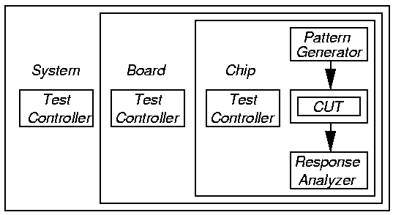
BIST Process
Test controller – Hardware that activates self-test simultaneously on all PCBs
Each board controller activates parallel chip BIST Diagnosis effective only if very high fault coverage

Slide 11
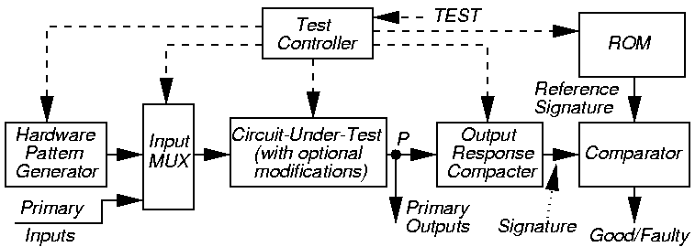
BIST Architecture
Note: BIST cannot test wires and transistors:
  From PI pins to Input MUX
  From POs to output pins

Slide 12
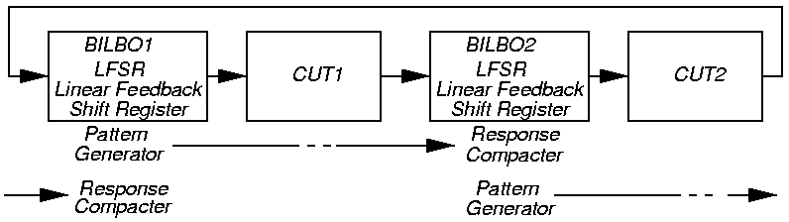
BILBO – Works as Both a PG and a RC
Built-in Logic Block Observer (BILBO) -- 4 modes:
  Flip-flop
  LFSR pattern generator
  LFSR response compacter
  Scan chain for flip-flops

Slide 13
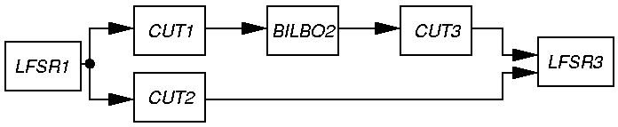
Complex BIST Architecture
Testing epoch I:
  LFSR1 generates tests for CUT1 and CUT2
  BILBO2 (LFSR3) compacts CUT1 (CUT2)
Testing epoch II:
  BILBO2 generates test patterns for CUT3
  LFSR3 compacts CUT3 response

Slide 14
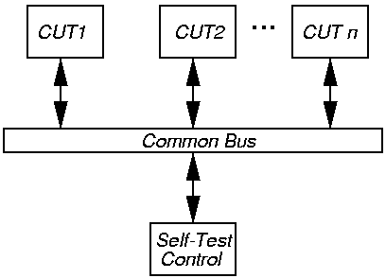
Bus-Based BIST Architecture
Self-test control broadcasts patterns to each CUT over bus – parallel pattern generation
Awaits bus transactions showing CUT’s responses to the patterns: serialized compaction

Slide 15
Pattern Generation
Store in ROM – too expensive
Exhaustive
Pseudo-exhaustive
Pseudo-random (LFSR) – Preferred method
Binary counters – use more hardware than LFSR
Modified counters
Test pattern augmentation
  LFSR combined with a few patterns in ROM
  Hardware diffracter – generates pattern cluster in neighborhood of pattern stored in ROM

Slide 16
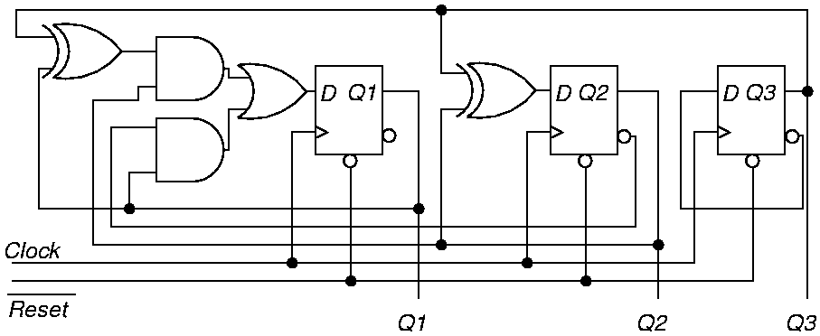
Exhaustive Pattern Generation
Shows that every state and transition works
For n-input circuits, requires all 2^{n} vectors
Impractical for n > 20

Slide 17
Pseudo-Exhaustive Method
Partition large circuit into fanin cones
  Backtrace from each PO to PIs influencing it
  Test fanin cones in parallel
Reduced # of tests from 2⁸ = 256 to 2⁵ x 2 = 64
  Incomplete fault coverage

Slide 18
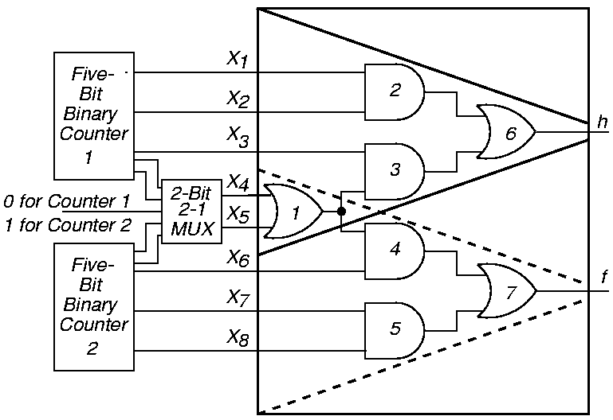
Pseudo-Exhaustive Pattern Generation

Slide 19
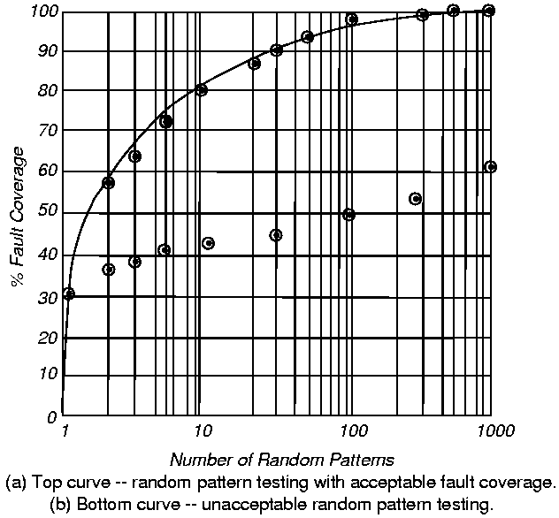
Random Pattern Testing
Bottom:
Random-
Pattern
Resistant
circuit

Slide 20
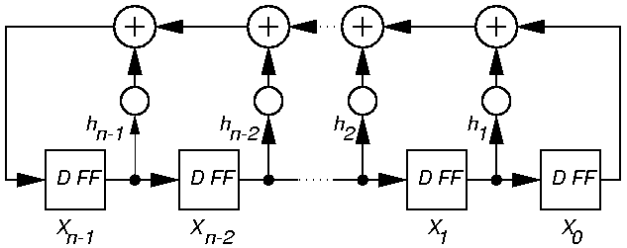
Pseudo-Random Pattern Generation
Standard Linear Feedback Shift Register (LFSR)
  Produces patterns algorithmically – repeatable
  Has most of desirable random # properties
Need not cover all 2^{n} input combinations
Long sequences needed for good fault coverage

Slide 21
Matrix Equation for Standard LFSR
X₀ (t + 1)
X₁ (t + 1)
.
.
.
X_{n-3} (t + 1)
X_{n-2} (t + 1)
X_{n-1} (t + 1)
0
0
.
.
.
0
0
1
1
0
.
.
.
0
0
h₁
0
1
.
.
.
0
0
h₂
…
…
…
…
…
0
0
.
.
.
1
0
h_{n-2}
0
0
.
.
.
0
1
h_{n-1}
X₀ (t)
X₁ (t)
.
.
.
X_{n-3} (t)
X_{n-2} (t)
X_{n-1} (t)
=
X (t + 1) = T_{s} X (t) (T_{s} is companion matrix)

Slide 22
LFSR Implements a Galois Field
Galois field (mathematical system):
  Multiplication by x same as right shift of LFSR
  Addition operator is XOR ( )
T_{s} companion matrix:
  1st column 0, except nth element which is always 1 (X₀ always feeds X_{n-1})
  Rest of row n – feedback coefficients h_{i}
  Rest is identity matrix I – means a right shift
Near-exhaustive (maximal length) LFSR
  Cycles through 2^{n} – 1 states (excluding all-0)
  1 pattern of n 1’s, one of n-1 consecutive 0’s

Slide 23
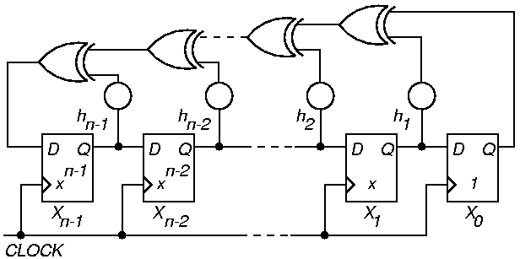
Standard n-Stage LFSR Implementation
Autocorrelation – any shifted sequence same as original in 2^{n-1} – 1 bits, differs in 2^{n-1} bits
If h_{i} = 0, that XOR gate is deleted

Slide 24
LFSR Theory
Cannot initialize to all 0’s – hangs
If X is initial state, progresses through states X, T_{s} X, T_{s}² X, T_{s}³ X, …
Matrix period:
  Smallest k such that T_{s}^{k} = I
  k LFSR cycle length
Described by characteristic polynomial:
  f (x) = |T_{s} – I X |
  = 1 + h₁ x + h₂ x² + … + h_{n-1} x^{n-1} + x^{n}

Slide 25
LFSR Fault Coverage Projection
Fault detection probability by a random number
  p (x) dx = fraction of detectable faults with detection probability between x and x + dx
  p (x) dx 0 when 0 x 1
  p (x) dx = 1
Exist p (x) dx faults with detection probability x
Mean coverage of those faults is x p (x) dx
Mean fault coverage y_{n} of 1st n vectors:
  y_{n} 1 – I (n) + (15.6)
1
0
n
total faults
1
where
  I (n) = (1 – x)^{n} p (x) dx
0

Slide 26
LFSR Fault Coverage & Vector Length Estimation
Random-fault-detection (RFD) variable:
  Vector # at which fault first detected
  w_{i} # faults with RFD variable i
So p (x) = Σ w_{i} p_{i} (x)
n_{s} size of sample simulated; N # test vectors
w₀ n_{s} - Σ w_{i}
Method:
  Estimate random first detect variables w_{i} from fault simulator using fault sampling
  Estimate I (n) using book Equation 15.8
  Obtain test length by inverting Equation 15.6 & solving numerically
1
n_{s}
N
i = 1
N
i = 1

Slide 27
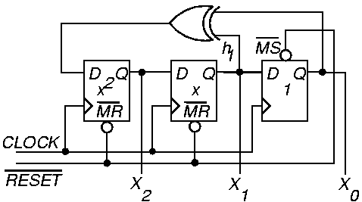
Example External XOR LFSR
Characteristic polynomial f (x) = 1 + x + x³
  (read taps from right to left)

Slide 28
External XOR LFSR
Pattern sequence for example LFSR (earlier):
Always have 1 and x^{n} terms in polynomial
Never repeat an LFSR pattern more than 1 time –Repeats same error vector, cancels fault effect
X₀
X₁
X₂
1
0
0
0
0
1
0
1
0
1
0
1
0
1
1
1
1
1
1
1
0
1
0
0
0
0
1
…
X₀ (t + 1)
X₁ (t + 1)
X₂ (t + 1)
0
0
1
1
0
1
0
1
0
X₀ (t)
X₁ (t)
X₂ (t)
=

Slide 29
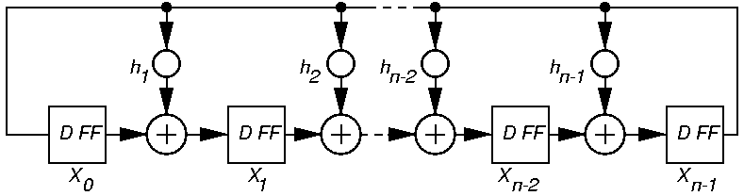
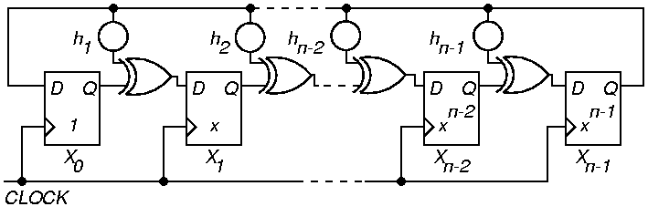
Generic Modular LFSR

Slide 30
Modular Internal XOR LFSR
Described by companion matrix T_{m} = T_{s} ^{T}
Internal XOR LFSR – XOR gates in between D flip-flops
Equivalent to standard External XOR LFSR
  With a different state assignment
  Faster – usually does not matter
  Same amount of hardware
X (t + 1) = T_{m} x X (t)
f (x) = | T_{m} – I X |
= 1 + h₁ x + h₂ x² + … + h_{n-1} x^{n-1} + x^{n}
Right shift – equivalent to multiplying by x, and then dividing by characteristic polynomial and storing the remainder

Slide 31
Modular LFSR Matrix
X₀ (t + 1)
X₁ (t + 1)
X₂ (t + 1)
.
.
.
X_{n-3} (t + 1)
X_{n-2} (t + 1)
X_{n-1} (t + 1)
0
1
0
.
.
.
0
0
0
0
0
1
.
.
.
0
0
0
0
0
0
.
.
.
0
0
0
…
…
…
…
…
…
0
0
0
.
.
.
0
1
0
0
0
0
.
.
.
0
0
1
1
h₁
h₂
.
.
.
h_{n-3}
h_{n-2}
h_{n-1}
X₀ (t)
X₁ (t)
X₂ (t)
.
.
.
X_{n-3} (t)
X_{n-2} (t)
X_{n-1} (t)
=

Slide 32
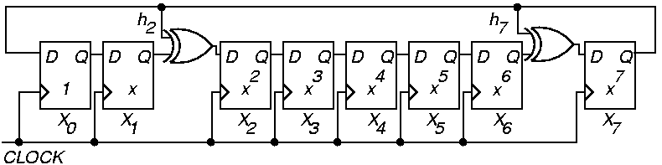
Example Modular LFSR
f (x) = 1 + x² + x⁷ + x⁸
Read LFSR tap coefficients from left to right

Slide 33
Primitive Polynomials
Want LFSR to generate all possible 2^{n} – 1 patterns (except the all-0 pattern)
Conditions for this – must have a primitive polynomial:
  Monic – coefficient of x^{n} term must be 1
    Modular LFSR – all D FF’s must right shift through XOR’s from X₀ through X₁, …, through X_{n-1}, which must feed back directly to X₀
    Standard LFSR – all D FF’s must right shift directly from X_{n-1} through X_{n-2}, …, through X₀, which must feed back into X_{n-1} through XORing feedback network

Slide 34
Primitive Polynomials (continued)
  Characteristic polynomial must divide the polynomial 1 – x^{k} for k = 2^{n} – 1, but not for any smaller k value
  See Appendix B of book for tables of primitive polynomials
If p (error) = 0.5, no difference between behavior of primitive & non-primitive polynomial
But p (error) is rarely = 0.5 In that case, non-primitive polynomial LFSR takes much longer to stabilize with random properties than primitive polynomial LFSR

Slide 35
Weighted Pseudo-Random Pattern Generation
s-a-0
F
1
256
If p (1) at all PIs is 0.5, p_{F} (1) = 0.5⁸ =
Will need enormous # of random patterns to test a stuck-at 0 fault on F -- LFSR p (1) = 0.5
  We must not use an ordinary LFSR to test this
IBM – holds patents on weighted pseudo-random pattern generator in ATE
f
1
256
255
256
p_{F} (0) = 1 – =

Slide 36
Weighted Pseudo-Random Pattern Generator
LFSR p (1) = 0.5
Solution: Add programmable weight selection and complement LFSR bits to get p (1)’s other than 0.5
Need 2-3 weight sets for a typical circuit
Weighted pattern generator drastically shortens pattern length for pseudo-random patterns

Slide 37
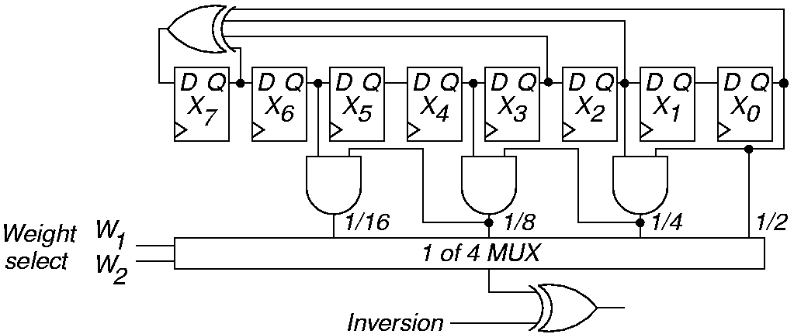
Weighted Pattern Gen.
w₁
0
0
0
0
w₂
0
0
1
1
Inv.
0
1
0
1
p (output)
½
½
¼
3/4
w₁
1
1
1
1
w₂
0
0
1
1
Inv.
0
1
0
1
p (output)
1/8
7/8
1/16
15/16

Slide 38
Cellular Automata (CA)
Superior to LFSR – even “more” random
  No shift-induced bit value correlation
  Can make LFSR more random with linear phase shifter
Regular connections – each cell only connects to local neighbors
x_{c-1} (t) x_{c} (t) x_{c+1} (t)
Gives CA cell connections
111 110 101 100 011 010 001 000
x_{c} (t + 1) 0 1 0 1 1 0 1 0
2⁶ + 2⁴ + 2³ + 2¹ = 90 Called Rule 90
x_{c} (t + 1) = x_{c-1} (t) x_{c+1} (t)

Slide 39
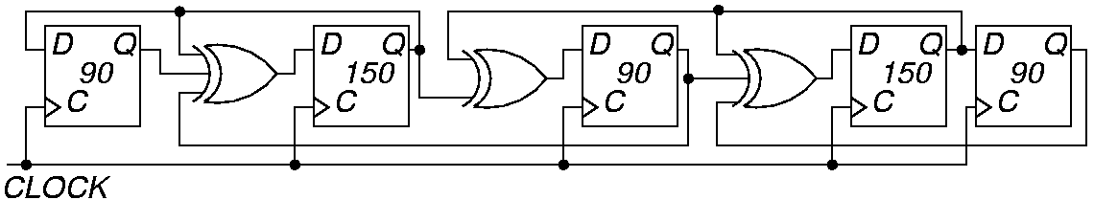
Cellular Automaton
Five-stage hybrid cellular automaton
Rule 150: x_{c} (t + 1) = x_{c-1} (t) x_{c} (t) x_{c+1} (t)
Alternate Rule 90 and Rule 150 CA

Slide 40
Test Pattern Augmentation
Secondary ROM – to get LFSR to 100% SAF coverage
  Add a small ROM with missing test patterns
  Add extra circuit mode to Input MUX – shift to ROM patterns after LFSR done
  Important to compact extra test patterns
Use diffracter:
  Generates cluster of patterns in neighborhood of stored ROM pattern
Transform LFSR patterns into new vector set
Put LFSR and transformation hardware in full-scan chain

Slide 41
Response Compaction
Severe amounts of data in CUT response to LFSR patterns – example:
  Generate 5 million random patterns
  CUT has 200 outputs
  Leads to: 5 million x 200 = 1 billion bits response
Uneconomical to store and check all of these responses on chip
Responses must be compacted

Slide 42
Definitions
Aliasing – Due to information loss, signatures of good and some bad machines match
Compaction – Drastically reduce # bits in original circuit response – lose information
Compression – Reduce # bits in original circuit response – no information loss – fully invertible (can get back original response)
Signature analysis – Compact good machine response into good machine signature. Actual signature generated during testing, and compared with good machine signature
Transition Count Response Compaction – Count # transitions from 0 1 and 1 0 as a signature

Slide 43
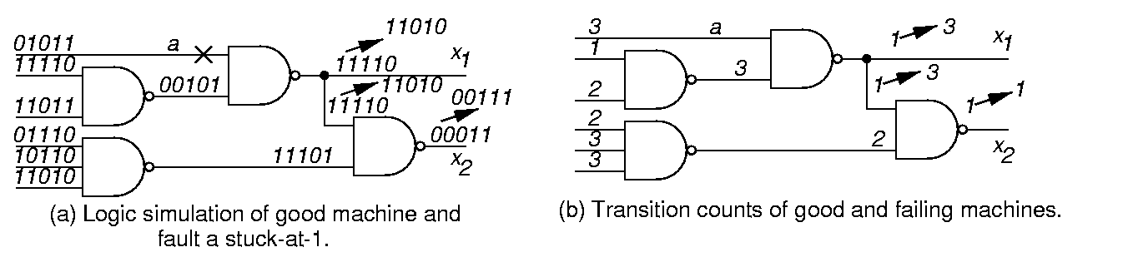
Transition Counting

Slide 44
Transition Counting Details
Transition count:
C (R) = Σ (r_{i} r_{i-1}) for all m primary outputs
To maximize fault coverage:
  Make C (R0) – good machine transition count – as large or as small as possible
m
i = 1

Slide 45
LFSR for Response Compaction
Use cyclic redundancy check code (CRCC) generator (LFSR) for response compacter
Treat data bits from circuit POs to be compacted as a decreasing order coefficient polynomial
CRCC divides the PO polynomial by its characteristic polynomial
  Leaves remainder of division in LFSR
  Must initialize LFSR to seed value (usually 0) before testing
After testing – compare signature in LFSR to known good machine signature
Critical: Must compute good machine signature

Slide 46
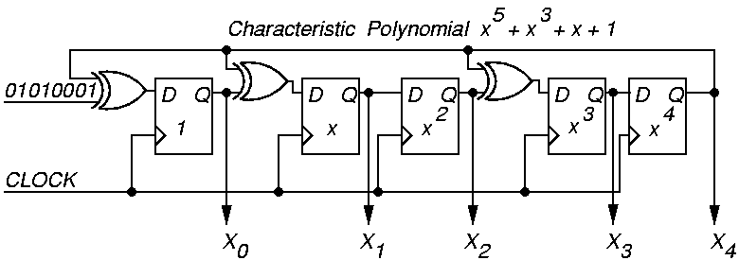
Example Modular LFSR Response Compacter
LFSR seed value is “00000”

Slide 47
Polynomial Division
Inputs
Initial State
1
0
0
0
1
0
1
0
X⁰
0
1
0
0
0
1
1
1
1
X¹
0
0
1
0
0
0
0
1
0
X²
0
0
0
1
0
0
0
0
1
X³
0
0
0
0
1
0
1
0
1
X⁴
0
0
0
0
0
1
0
1
0
Logic
Simulation:
Logic simulation: Remainder = 1 + x² + x³
0 1 0 1 0 0 0 1
0 x⁰ + 1 x¹ + 0 x² + 1 x³ + 0 x⁴ + 0 x⁵ + 0 x⁶ + 1 x⁷
.
.
.
.
.
.
.
.

Slide 48
Symbolic Polynomial Division
x²
x⁷
x⁷
+ 1
+ x⁵
x⁵
x⁵
x⁵ + x³ + x + 1
+ x³
+ x³
+ x³
x³
+ x
+ x
+ x
+ x²
+ x²
+ x²
+ 1
+ 1
remainder
Remainder matches that from logic simulation
of the response compacter!

Slide 49
Multiple-Input Signature Register (MISR)
Problem with ordinary LFSR response compacter:
  Too much hardware if one of these is put on each primary output (PO)
Solution: MISR – compacts all outputs into one LFSR
  Works because LFSR is linear – obeys superposition principle
  Superimpose all responses in one LFSR – final remainder is XOR sum of remainders of polynomial divisions of each PO by the characteristic polynomial

Slide 50
MISR Matrix Equation
d_{i} (t) – output response on PO_{i} at time t
X₀ (t + 1)
X₁ (t + 1)
.
.
.
X_{n-3} (t + 1)
X_{n-2} (t + 1)
X_{n-1} (t + 1)
0
0
.
.
.
0
0
1
1
0
.
.
.
0
0
h₁
…
…
…
…
…
0
0
.
.
.
1
0
h_{n-2}
0
0
.
.
.
0
1
h_{n-1}
X₀ (t)
X₁ (t)
.
.
.
X_{n-3} (t)
X_{n-2} (t)
X_{n-1} (t)
d₀ (t)
d₁ (t)
.
.
.
d_{n-3} (t)
d_{n-2} (t)
d_{n-1} (t)
=
+

Slide 51
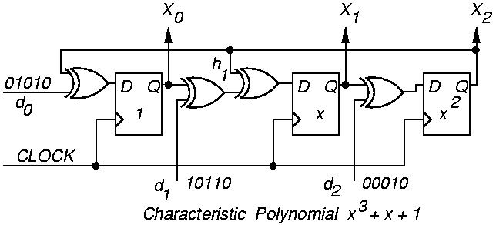
Modular MISR Example
X₀ (t + 1)
X₁ (t + 1)
X₂ (t + 1)
0
1
0
0
0
1
1
1
0
X₀ (t)
X₁ (t)
X₂ (t)
d₀ (t)
d₁ (t)
d₂ (t)
=
+

Slide 52
Multiple Signature Checking
Use 2 different testing epochs:
  1st with MISR with 1 polynomial
  2nd with MISR with different polynomial
Reduces probability of aliasing –
  Very unlikely that both polynomials will alias for the same fault
Low hardware cost:
  A few XOR gates for the 2nd MISR polynomial
  A 2-1 MUX to select between two feedback polynomials

Slide 53
Aliasing Probability
Aliasing – when bad machine signature equals good machine signature
Consider error vector e (n) at POs
  Set to a 1 when good and faulty machines differ at the PO at time t
P_{al} aliasing probability
p probability of 1 in e (n)
Aliasing limits:
  0 < p ½, p^{k} P_{al} (1 – p)^{k}
  ½ p 1, (1 – p)^{k} P_{al} p^{k}

Slide 54
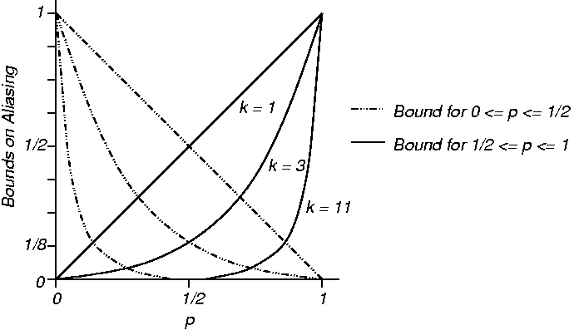
Aliasing Probability Graph

Slide 55
Additional MISR Aliasing
MISR has more aliasing than LFSR on single PO
  Error in CUT output d_{j} at t_{i}, followed by error in output d_{j+h} at t_{i+h}, eliminates any signature error if no feedback tap in MISR between bits Q_{j} and Q_{j+h}.

Slide 56
Aliasing Theorems
Theorem 15.1: Assuming that each circuit PO d_{ij} has probability p of being in error, and that all outputs d_{ij} are independent, in a k-bit MISR, P_{al} = 1/(2^{k}), regardless of initial condition of MISR. Not exactly true – true in practice.
Theorem 15.2: Assuming that each PO d_{ij} has probability p_{j} of being in error, where the p_{j} probabilities are independent, and that all outputs d_{ij} are independent, in a k-bit MISR, P_{al} = 1/(2^{k}), regardless of the initial condition.

Slide 57
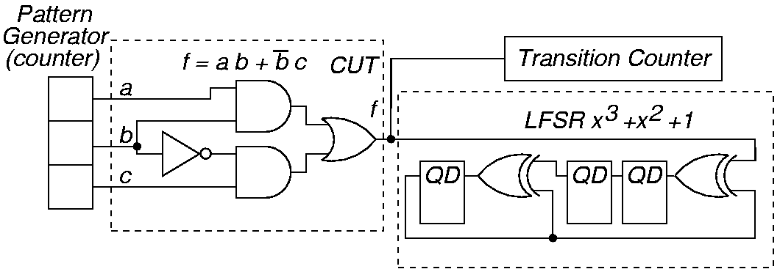
Experiment Hardware
3 bit exhaustive binary counter for pattern
generator

Slide 58
Transition Counting vs. LFSR
LFSR aliases for f sa1, transition counter for a sa1
Responses
Pattern
abc
000
001
010
011
100
101
110
111
Transition Count
LFSR
Good
0
1
0
0
0
1
1
1
3
001
a sa1
0
1
1
1
0
1
1
1
Signatures
3
101
f sa1
1
1
1
1
1
1
1
1
0
001
b sa1
0
0
0
0
1
1
1
1
1
010

Slide 59
Summary
LFSR pattern generator and MISR response compacter – preferred BIST methods
BIST has overheads: test controller, extra circuit delay, Input MUX, pattern generator, response compacter, DFT to initialize circuit & test the test hardware
BIST benefits:
  At-speed testing for delay & stuck-at faults
  Drastic ATE cost reduction
  Field test capability
  Faster diagnosis during system test
  Less effort to design testing process
  Shorter test application times

